Slide 1
Digital Portfolio
STUDENT NAME: THIRUSELVAN J
REGISTER NO AND NMID: 2428B0359/AD2D9486FD6DF8DAFB64A2A502452DF3
DEPARTMENT: BSc COMPUTER SCIENCE WITH DATA ANALYTICS
COLLEGE: KPR COLLEGE OF ART, SCIENCE, AND RESEARCH/BHARATHIAR UNIVERSITY

Slide 2
PROJECT TITLE
Sports and physical activities achievements

Slide 3


AGENDA
Problem Statement
Project Overview
End Users
Tools and Technologies
Portfolio design and Layout
Features and Functionality
Results and Screenshots
Conclusion
Github Link
3/21/2024 Annual Review

Slide 4

PROBLEM STATEMENT
In today’s competitive job market, traditional resumes and documents often fail to highlight the overall profile of a candidate. While they may capture academic details, they do not effectively represent technical skills, projects, and extracurricular achievements such as sports or physical activities. As a result, employers and recruiters may not get a complete picture of the candidate’s abilities. To overcome this limitation, there is a need for a modern, interactive, and visually appealing digital portfolio that presents academic, technical, and extracurricular accomplishments in a professional manner.

Slide 5

PROJECT OVERVIEW
This project involves the creation of a digital portfolio website for Thiruselvan, a B.Sc. Computer Science with Data Analytics graduate. The portfolio highlights his academic qualifications, technical skills, projects, and sports or physical activity achievements. Designed using HTML, CSS, and JavaScript, the website is fully responsive and interactive, ensuring smooth navigation across devices. It acts as an effective online presence that allows recruiters, coaches, and peers to evaluate the candidate’s profile quickly and easily.

Slide 6

WHO ARE THE END USERS?
The digital portfolio is designed for multiple types of users. Employers can use it to evaluate the candidate’s suitability for job opportunities. Recruiters benefit by quickly scanning through both technical and extracurricular achievements. Coaches and mentors can view the sports and physical activities accomplishments, while peers and collaborators can explore the portfolio for academic or project-related collaborations.

Slide 7

TOOLS AND TECHNIQUES
The portfolio was developed using simple yet powerful web technologies. HTML, CSS, and JavaScript form the foundation of the design and functionality. Git and GitHub were used for version control, ensuring proper project management and collaboration. GitHub Pages serves as the hosting platform, allowing the portfolio to be published online and accessible from anywhere. The design approach follows responsive web design principles, ensuring compatibility with mobile, tablet, and desktop screens.

Slide 8
POTFOLIO DESIGN AND LAYOUT
The portfolio follows a clean and structured layout divided into several sections. The homepage introduces the student with a brief profile. Academic details and technical skills are presented in organized formats, followed by a projects section that showcases completed works. A dedicated sports and achievements section highlights extracurricular activities. Finally, a contact section allows interested users to reach out easily. This logical layout makes the portfolio both professional and easy to navigate.
8

Slide 9
FEATURES AND FUNCTIONALITY
The portfolio website is modern and responsive, adapting seamlessly to different devices. It includes smooth navigation features for a user-friendly experience. The design is visually appealing and highlights both academic and extracurricular achievements in one place. Since it is hosted online, the portfolio can be easily updated and shared, making it dynamic and more useful compared to a traditional static resume.

Slide 10
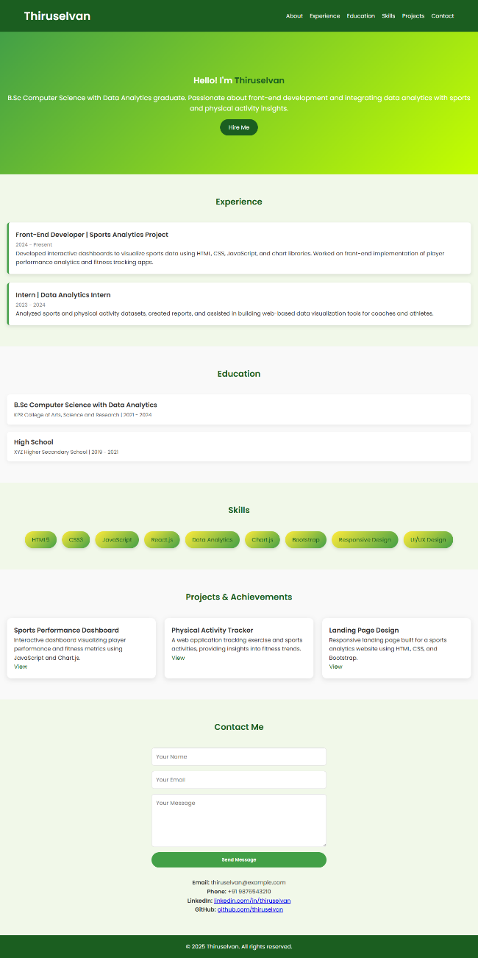

RESULTS AND SCREENSHOTS
3/21/2024 Annual Review
10

Slide 11
CONCLUSION
The digital portfolio provides a more effective way of showcasing a student’s overall profile compared to traditional resumes. It highlights academic, technical, and extracurricular achievements in a single interactive platform. The portfolio enhances the student’s professional online presence and offers recruiters, employers, and peers a quick and easy way to evaluate the candidate’s skills and potential.
11

Slide 12
GITHUB LINK
https://thiruselvanjagateesh-13.github.io/digital-portfolio/
12

